Slide 1
CABLE as a key component in ACCESS: present status and the future
Ying-Ping Wang CSIRO Oceans and Atmosphere

Slide 2
CABLE: present status and its users
CABLE are managed through SVN repository;
CABLE has successfully implemented into ACCESS1.4 and evaluated against JULES, and is being implemented into ACCESS 2.0, and also into JULES framework;
Since 2013, we have 109 users outside CSIRO from 65 other institutions in 14 countries (including 40 students from 6 other countries). In 2017, 5 high impact papers published, and 4 more under review.

Slide 3
Increasing CABLE-related journal papers

Slide 4
Futures (1 to 2 years)
New science
Land use change
Biological N fixation
Benchmarking
the first protocol
JULES/CABLE comparison
Applications
Effects of land use change on carbon-concentration feedback
Nonlinear carbon-climate feedbacks in ACCESS
……..more

Slide 5
Benchmarking
Poor
Poor

Slide 6
Future (long term> 2 years)
Key science development guided by benchmarking and significant science and policy issues
Trait-based global land modelling
climatic consequence of human activities
interactions with surface air chemistry
Forecasting
Better methods for using wide range field observations to improve CABLE
Surrogate modelling and ensemble simulations
Using models to test observation-based hypotheses.

Slide 7
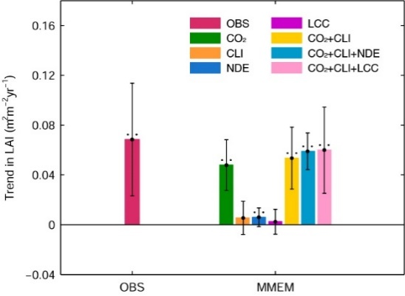
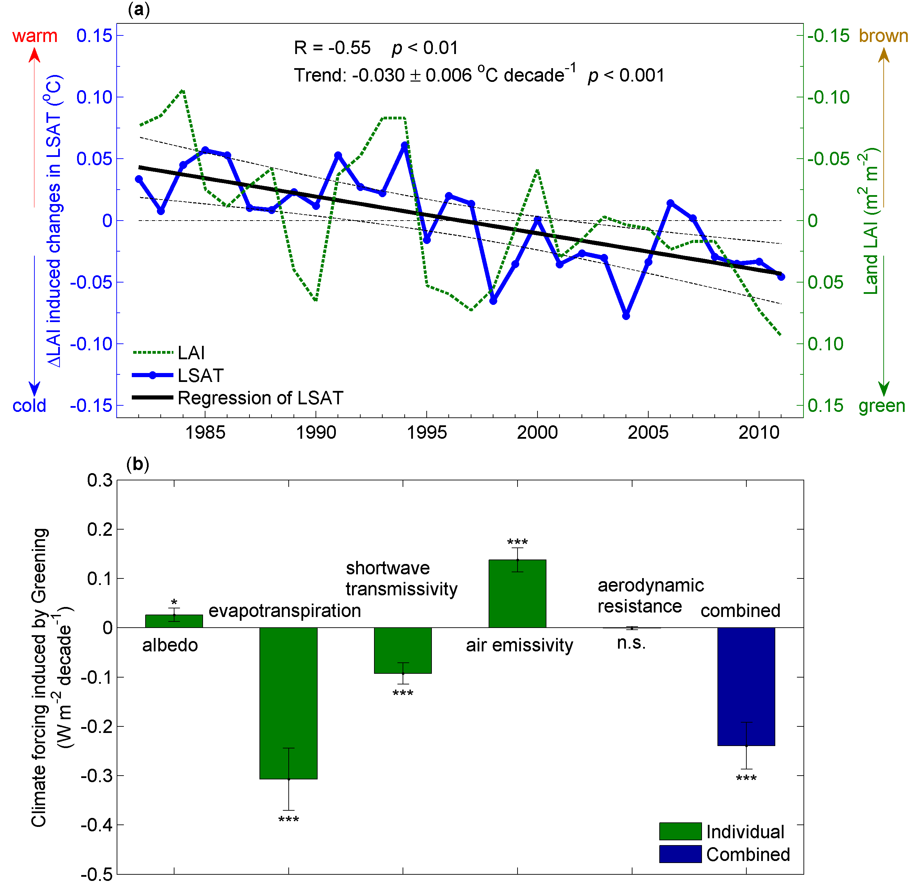
Attribution (Zhu et al. 2016 and Zeng et al. 2017, NCC)
Warmer
Greener
Overall greening slowed down surface warming by 0.09±0.02ºC since 1982, or 12% over last 3 decades.

